Slide 1
IEEE AGENTICAI ’26
01
Engineering
Multi-Agent Systems
Roles, typed handoffs, and governed execution
Rahul Verma
Software Engineer, Cisco
Notes:
TIMING
00:00–01:00
PURPOSE
Engineering
Multi-Agent Systems
WHAT TO SAY
The engineering question is how to divide reasoning, inspect the handoffs, and control execution. We will establish the design decisions first, implement roles with CrewAI, then use n8n to control a workflow.
AUDIENCE PROMPT
Ask participants to identify the boundary that this slide makes visible.
DEMO CUE
FALLBACK
Use the on-slide diagram or excerpt. Do not imply a live run occurred.
TRANSITION
A single agent can hide several different responsibilities inside one loop.
SOURCES
Supplied deck: /Users/rahul/Downloads/6836F75A-45BF-4A3C-9CE4-86973707B18DIEEE_AgenticAI_MultiAgent_Workflows_FINAL_v10.pptx. Local reconstructed demos and verification are available under /Users/rahul/Documents/IISC DEMO/demos. Archived recorded outputs are labeled separately. Conceptual diagrams and proposed extensions are labeled on slide.

Slide 2
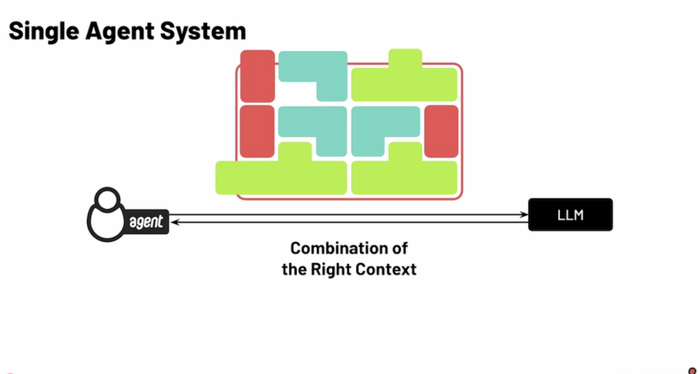
WHY MULTIPLE AGENTS
02
The single-agent coupling problem
One loop may hold the plan, tool access, working context, and final judgment.
Shared context
Earlier mistakes can influence later steps.
Shared permissions
Tool access can span analysis and action.
Opaque handoffs
Intermediate decisions are harder to isolate.
Interpret, investigate, evaluate, act
Notes:
TIMING
01:00–02:30
PURPOSE
The single-agent coupling problem
WHAT TO SAY
This is a design failure mode, not a claim that single agents always fail. When one agent interprets, investigates, evaluates and acts, an error can propagate across those duties. A longer prompt does not by itself create a separately testable contract or permission boundary.
AUDIENCE PROMPT
Which responsibility would you want to test independently?
DEMO CUE
Which responsibility would you want to test independently?
FALLBACK
Use the on-slide diagram or excerpt. Do not imply a live run occurred.
TRANSITION
Role separation is useful when it produces a measurable benefit.
SOURCES
Supplied deck: /Users/rahul/Downloads/6836F75A-45BF-4A3C-9CE4-86973707B18DIEEE_AgenticAI_MultiAgent_Workflows_FINAL_v10.pptx. Local reconstructed demos and verification are available under /Users/rahul/Documents/IISC DEMO/demos. Archived recorded outputs are labeled separately. Conceptual diagrams and proposed extensions are labeled on slide.
FIGURE SOURCE
User-supplied DeepLearning.AI / CrewAI course diagram: /Users/rahul/Downloads/Screenshot 2026-10-19 at 12.53.46 AM.png
The screenshot is a raster reference image; its attribution is preserved.

Slide 3
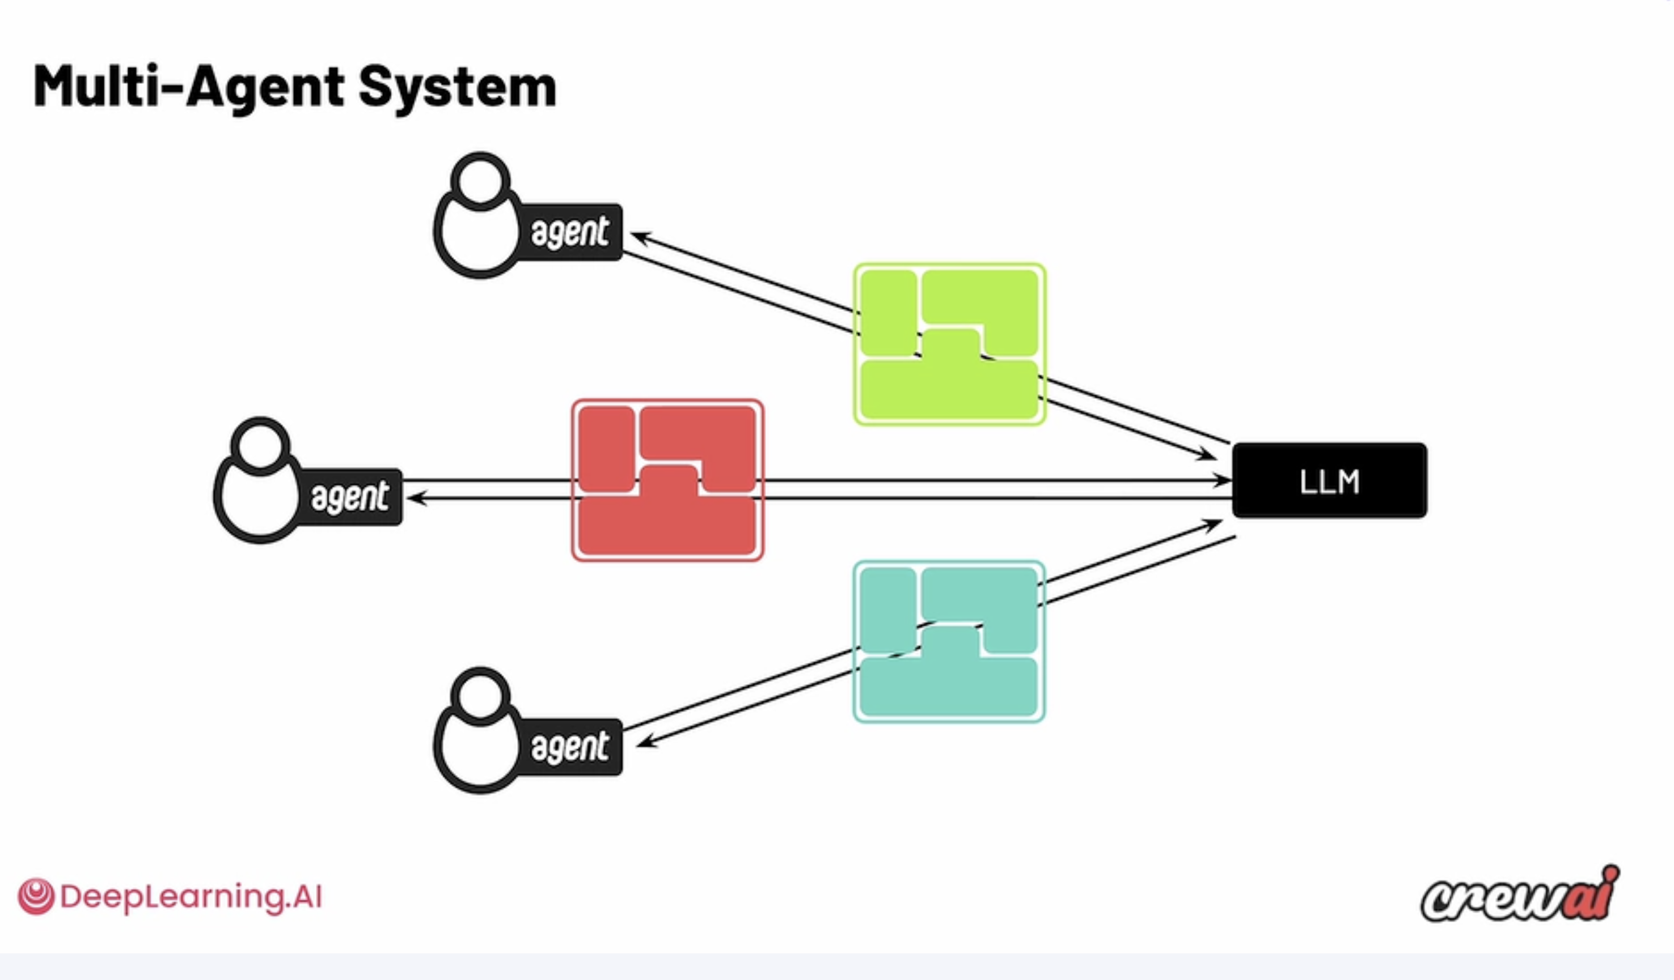
FOCUSED CONTEXT
03
Each agent gets the context it needs
Relevant instructions, tools, and evidence travel with each specialist.
Role-specific rules
Each specialist gets the instructions and tools for its job.
Relevant evidence
Share the facts each task needs. One assistant can coordinate the team.
Notes:
TIMING
02:30–04:00
PURPOSE
Each agent gets the context it needs
WHAT TO SAY
An agent combines a role, tools and context with a model call. Give each specialist the material required for its own decision. Specialized contexts can use the same model, as shown here. The user can still interact through one assistant. Compare the focused lanes with the shared-context problem on the previous slide.
AUDIENCE PROMPT
Which evidence does a reviewer need that an extractor does not?
DEMO CUE
Which evidence does a reviewer need that an extractor does not?
FALLBACK
Use the on-slide diagram or excerpt. Do not imply a live run occurred.
TRANSITION
Now decide where specialization provides enough value.
SOURCES
Supplied deck: /Users/rahul/Downloads/6836F75A-45BF-4A3C-9CE4-86973707B18DIEEE_AgenticAI_MultiAgent_Workflows_FINAL_v10.pptx. Local reconstructed demos and verification are available under /Users/rahul/Documents/IISC DEMO/demos. Archived recorded outputs are labeled separately. Conceptual diagrams and proposed extensions are labeled on slide.
FIGURE SOURCE
User-supplied DeepLearning.AI / CrewAI course diagram: /Users/rahul/Downloads/Screenshot 2026-10-19 at 12.53.58 AM.png
The screenshot is a raster reference image; its attribution is preserved.
REFERENCE
Adapted as editable diagrams from the user-supplied single-agent and multi-agent context screenshots and Module 3 transcript.
https://www.anthropic.com/engineering/effective-context-engineering-for-ai-agents

Slide 4
ARCHITECTURE CHOICE
04
When multiple agents earn their cost
Use specialization when each role has a distinct contract and a testable job.
Useful separation
Coordination costs
Different tool permissions
Different evaluation criteria
Independent work to parallelize
More latency and model calls
Handoff failures and shared biases
More traces to evaluate
Keep one agent when a focused prompt and tool set already meet the acceptance criteria.
Notes:
TIMING
04:00–05:00
PURPOSE
When multiple agents earn their cost
WHAT TO SAY
A specialist can use a smaller tool set and a different evaluation criterion. Independent work may run in parallel. A separate reviewer can challenge an output but can still share model biases. Distinct acceptance criteria make the contribution of each role measurable. Start with one agent and split only when evaluation shows a reason.
AUDIENCE PROMPT
Would another agent improve a measurable failure, or just add another model call?
DEMO CUE
Would another agent improve a measurable failure, or just add another model call?
FALLBACK
Use the on-slide diagram or excerpt. Do not imply a live run occurred.
TRANSITION
The useful unit is the role plus its input and output contract.
SOURCES
Supplied deck: /Users/rahul/Downloads/6836F75A-45BF-4A3C-9CE4-86973707B18DIEEE_AgenticAI_MultiAgent_Workflows_FINAL_v10.pptx. Local reconstructed demos and verification are available under /Users/rahul/Documents/IISC DEMO/demos. Archived recorded outputs are labeled separately. Conceptual diagrams and proposed extensions are labeled on slide.

Slide 5
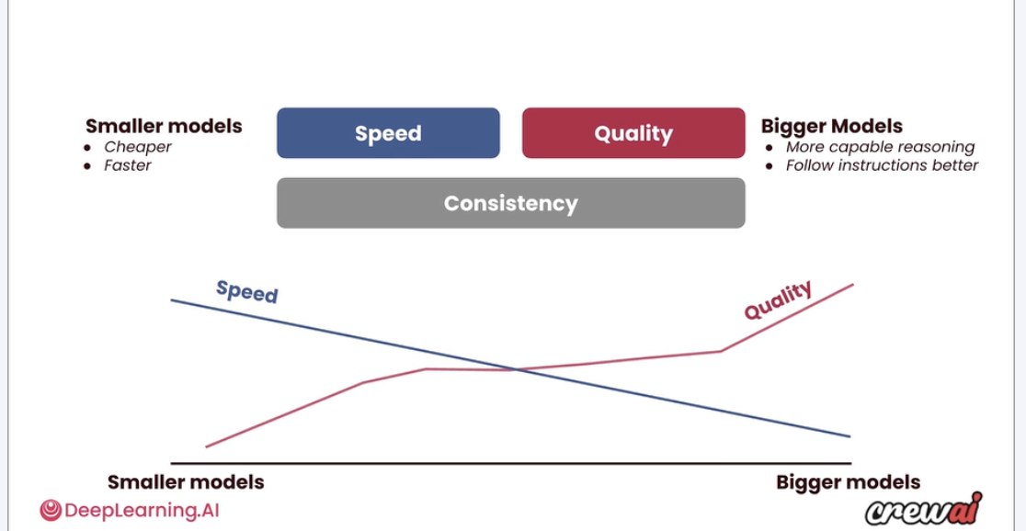
TASK-BASED MODEL SELECTION
05
A model choice for each responsibility
Use a smaller model for bounded work and a stronger model for complex reasoning.
Smaller model
Classification
Extraction
Routine formatting
Stronger model
Planning
Ambiguous decisions
Complex synthesis
Conceptual reference. Choose each role’s model using measured quality, latency, and cost.
Notes:
TIMING
05:00–06:30
PURPOSE
A model choice for each responsibility
WHAT TO SAY
Match the model to the task rather than giving every responsibility the same configuration. Candidate small-model work includes classification and extraction. Complex planning and synthesis may need a more capable model. Compare models on the same examples and choose the least costly model that meets the quality target. This is an architecture option; the live demos currently use Codex for every role.
AUDIENCE PROMPT
Which task in your system could use a smaller model after evaluation?
DEMO CUE
Which task in your system could use a smaller model after evaluation?
FALLBACK
Use the on-slide diagram or excerpt. Do not imply a live run occurred.
TRANSITION
Model selection and context selection affect different parts of the cost.
SOURCES
Supplied deck: /Users/rahul/Downloads/6836F75A-45BF-4A3C-9CE4-86973707B18DIEEE_AgenticAI_MultiAgent_Workflows_FINAL_v10.pptx. Local reconstructed demos and verification are available under /Users/rahul/Documents/IISC DEMO/demos. Archived recorded outputs are labeled separately. Conceptual diagrams and proposed extensions are labeled on slide.
FIGURE SOURCE
User-supplied DeepLearning.AI / CrewAI course diagram: /Users/rahul/Downloads/Screenshot 2026-10-19 at 12.59.16 AM 1.00.27 AM.png
The screenshot is a raster reference image; its attribution is preserved.
SOURCES
User-supplied model-size reference and transcript; redrawn as editable task/model lanes.
https://developers.openai.com/api/docs/guides/model-selection
https://developers.openai.com/api/docs/guides/latency-optimization

Slide 6
TOKEN AND COST EFFICIENCY
06
Focused context reduces repeated input
Illustrative arithmetic. The same three tasks receive either full or scoped context.
Input strategy | Inputs to the three tasks | Total input tokens
Full shared context | 12,000 + 12,000 + 12,000 | 36,000
Scoped task context | 2,000 + 4,000 + 3,000 | 9,000
27,000 fewer input tokens in this illustration
Smaller models can lower cost per token. Focused context reduces input-token volume.
Notes:
TIMING
06:30–08:00
PURPOSE
Focused context reduces repeated input
WHAT TO SAY
Two design choices support efficiency. A smaller model changes the price paid for comparable token usage. Scoped context changes how many input tokens a task receives. This hypothetical example holds the three tasks fixed. Full context gives each task 12000 input tokens. Scoped task inputs are 2000, 4000 and 3000 tokens, including their instructions and supplied context. These are teaching assumptions, not measured savings from our demo.
AUDIENCE PROMPT
Which documents or previous outputs could you leave out of each task’s input?
DEMO CUE
Which documents or previous outputs could you leave out of each task’s input?
FALLBACK
Use the on-slide diagram or excerpt. Do not imply a live run occurred.
TRANSITION
The communication graph lets us express those precise handoffs.
SOURCES
Supplied deck: /Users/rahul/Downloads/6836F75A-45BF-4A3C-9CE4-86973707B18DIEEE_AgenticAI_MultiAgent_Workflows_FINAL_v10.pptx. Local reconstructed demos and verification are available under /Users/rahul/Documents/IISC DEMO/demos. Archived recorded outputs are labeled separately. Conceptual diagrams and proposed extensions are labeled on slide.
SOURCES
https://developers.openai.com/api/docs/guides/cost-optimization
https://www.anthropic.com/engineering/effective-context-engineering-for-ai-agents
Arithmetic is hypothetical: 3 × 12000 = 36000; 2000 + 4000 + 3000 = 9000; difference = 27000 input tokens. Outputs and monetary prices are outside this illustration.

Slide 7
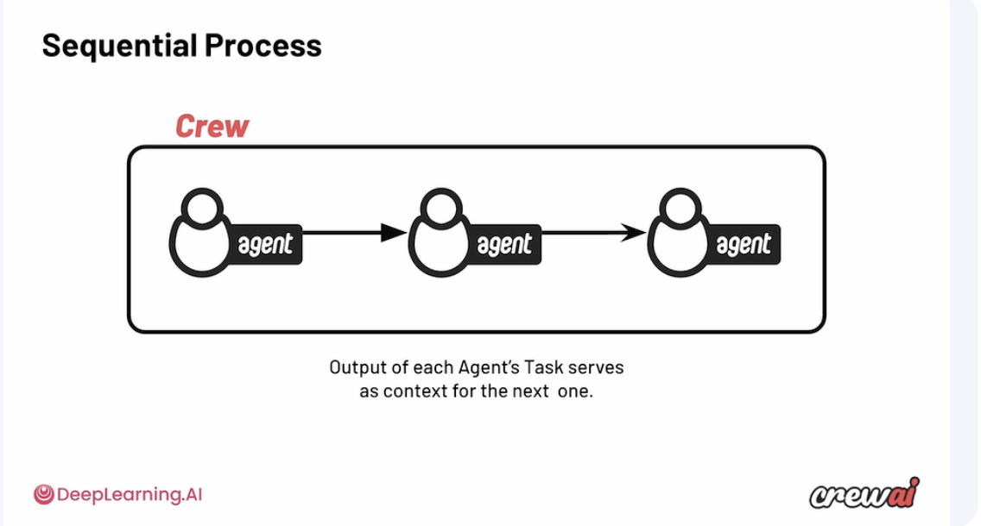
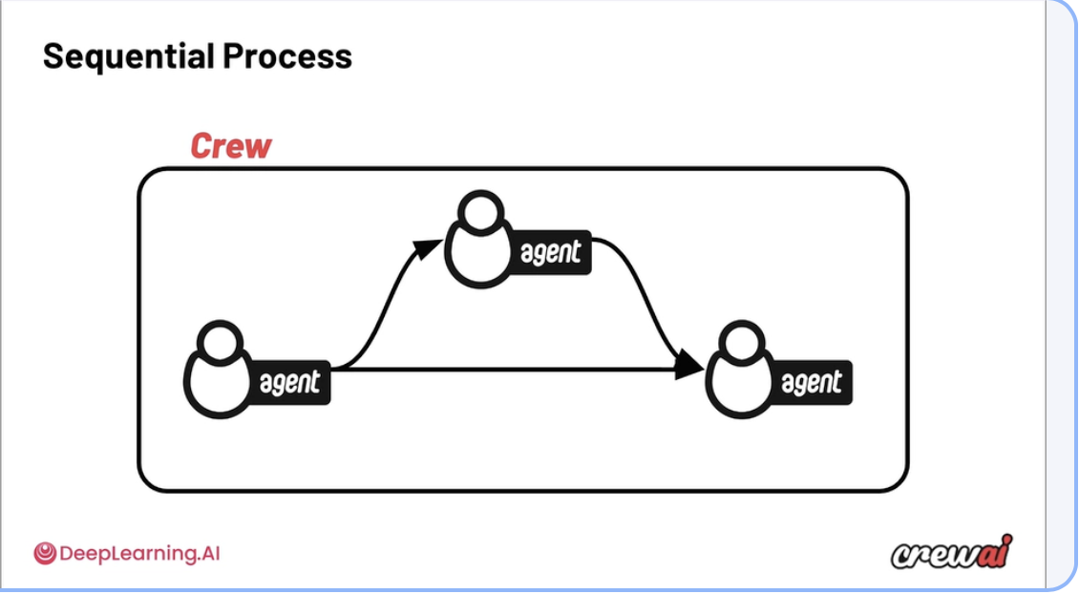
COMMUNICATION PATTERNS
07
Task order and context are separate choices
Sequential execution sets the order. Explicit context selects the inputs for each task.
Sequential handoff
Selective context
Each task supplies context to the next.
The final task receives both earlier outputs.
Notes:
TIMING
08:00–09:30
PURPOSE
Task order and context are separate choices
WHAT TO SAY
The top path is a sequential chain: plan, tests, implementation. The direct lower path supplies the plan to the implementer as well. An ordered process does not require us to pass the entire history to every task. Share the specific artifacts a task needs. Independent tasks can run concurrently once their required inputs are available.
AUDIENCE PROMPT
Does the implementer need only the test output, or both the plan and the tests?
DEMO CUE
Does the implementer need only the test output, or both the plan and the tests?
FALLBACK
Use the on-slide diagram or excerpt. Do not imply a live run occurred.
TRANSITION
A coordinator offers another way to assign work and reconcile results.
SOURCES
Supplied deck: /Users/rahul/Downloads/6836F75A-45BF-4A3C-9CE4-86973707B18DIEEE_AgenticAI_MultiAgent_Workflows_FINAL_v10.pptx. Local reconstructed demos and verification are available under /Users/rahul/Documents/IISC DEMO/demos. Archived recorded outputs are labeled separately. Conceptual diagrams and proposed extensions are labeled on slide.
FIGURE SOURCE
User-supplied DeepLearning.AI / CrewAI course diagram: /Users/rahul/Downloads/Screenshot 2026-10-19 at 1.01.09 AM.png
The screenshot is a raster reference image; its attribution is preserved.
FIGURE SOURCE
User-supplied DeepLearning.AI / CrewAI course diagram: /Users/rahul/Downloads/Screenshot 2026-10-19 at 1.01.20 AM.png
The screenshot is a raster reference image; its attribution is preserved.
REFERENCE
Editable adaptation of the supplied Sequential Process diagrams. Examples are conceptual.
https://docs.crewai.com/en/concepts/tasks
https://docs.crewai.com/en/concepts/processes

Slide 8
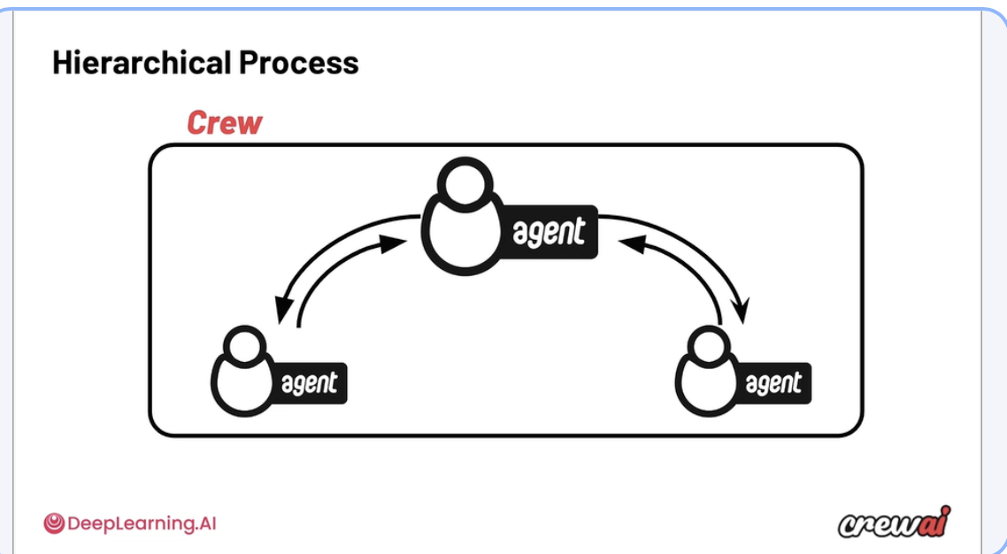
MANAGER AND WORKERS
08
A coordinator assigns work and reconciles results
Specialists keep bounded responsibilities. The coordinator assembles the final result.
Manager
Assigns work
Combines reports
Requests revisions
Specialists
Complete bounded tasks and return evidence.
Notes:
TIMING
09:30–11:00
PURPOSE
A coordinator assigns work and reconciles results
WHAT TO SAY
The coordinator divides the task, requests specialist work, and reconciles the returned reports. It can request a scoped revision when a report does not meet its criteria. This is a conceptual manager-worker hierarchy. Our live lab implements it with explicit sequential manager and worker tasks; it does not use CrewAI native hierarchical delegation. The application still owns permissions and final authorization.
AUDIENCE PROMPT
Which decisions belong to the coordinator, and which checks stay inside a specialist?
DEMO CUE
Which decisions belong to the coordinator, and which checks stay inside a specialist?
FALLBACK
Use the on-slide diagram or excerpt. Do not imply a live run occurred.
TRANSITION
These patterns need contracts so that every handoff can be inspected.
SOURCES
Supplied deck: /Users/rahul/Downloads/6836F75A-45BF-4A3C-9CE4-86973707B18DIEEE_AgenticAI_MultiAgent_Workflows_FINAL_v10.pptx. Local reconstructed demos and verification are available under /Users/rahul/Documents/IISC DEMO/demos. Archived recorded outputs are labeled separately. Conceptual diagrams and proposed extensions are labeled on slide.
FIGURE SOURCE
User-supplied DeepLearning.AI / CrewAI course diagram: /Users/rahul/Downloads/Screenshot 2026-10-19 at 1.02.17 AM.png
The screenshot is a raster reference image; its attribution is preserved.
REFERENCE
Editable adaptation of the user-supplied Hierarchical Process diagram and Module 3 transcript.
https://docs.crewai.com/en/concepts/processes
Local implementation: /Users/rahul/Documents/IISC DEMO/demos/crewai_hands_on/lab.py

Slide 9
MULTI-AGENT DESIGN
09
Contracts make collaboration inspectable
Separate interpretation from enforcement. A reviewer remains a fallible model.
Specialist role
Typed output
Consumer / workflow
Input + allowed tools
Schema + provenance
Checks + permissions
Bound the responsibility
and the stopping condition.
Expose what the role found
and what remains unknown.
Code enforces policy.
Tools enforce authority.
Notes:
TIMING
11:00–12:30
PURPOSE
Contracts make collaboration inspectable
WHAT TO SAY
Each role needs explicit inputs, allowed tools, output schema, and stopping condition. Schema validation checks structure. Application code checks deterministic policy. Tool permissions determine actual authority. Evaluate each role and the end-to-end task. Agent disagreement is not proof of correctness.
AUDIENCE PROMPT
Ask participants to identify the boundary that this slide makes visible.
DEMO CUE
FALLBACK
Use the on-slide diagram or excerpt. Do not imply a live run occurred.
TRANSITION
CrewAI gives us a concrete way to implement this role graph.
SOURCES
Supplied deck: /Users/rahul/Downloads/6836F75A-45BF-4A3C-9CE4-86973707B18DIEEE_AgenticAI_MultiAgent_Workflows_FINAL_v10.pptx. Local reconstructed demos and verification are available under /Users/rahul/Documents/IISC DEMO/demos. Archived recorded outputs are labeled separately. Conceptual diagrams and proposed extensions are labeled on slide.

Slide 10
CREWAI RUNNING EXAMPLE
10
CrewAI: three roles, one request
“Find black running shoes under ₹1,000. Ask me before ordering.”
Request Analyst
Offer Evaluator
Policy Reviewer
ShoppingRequest
EvaluationReport
Recommendation
Budget = ₹1,000
Category + colour
Eligibility checks
Evidence + unknowns
Rank eligible offers
No order authority
The application owns budget checks and tool permissions. The agents expose the reasoning.
Notes:
TIMING
12:30–14:30
PURPOSE
CrewAI: three roles, one request
WHAT TO SAY
This is the first appearance of the retail example. Keep the budget at 1000 throughout. Required intent is black running shoes with a total under 1000 and approval before ordering. Size, stock, delivery and returns are unknown unless evidenced. They may become hard constraints if explicitly requested. The source CrewAI saved run uses a different 4000 budget; rerun with this request before presenting the revised case.
AUDIENCE PROMPT
Which of these agents should receive a purchase tool? None.
DEMO CUE
Which of these agents should receive a purchase tool? None.
FALLBACK
Use the on-slide diagram or excerpt. Do not imply a live run occurred.
TRANSITION
The framework expresses these roles as agents and tasks.
SOURCES
Supplied deck: /Users/rahul/Downloads/6836F75A-45BF-4A3C-9CE4-86973707B18DIEEE_AgenticAI_MultiAgent_Workflows_FINAL_v10.pptx. Local reconstructed demos and verification are available under /Users/rahul/Documents/IISC DEMO/demos. Archived recorded outputs are labeled separately. Conceptual diagrams and proposed extensions are labeled on slide.

Slide 11
CREWAI IMPLEMENTATION
11
CrewAI wiring that matters
A sequential crew connects typed tasks through explicit context.
Agent
parsed = Task(agent=analyst,
output_pydantic=ShoppingRequest)
checked = Task(agent=evaluator,
context=[parsed],
output_pydantic=EvaluationReport)
reviewed = Task(agent=reviewer,
context=[parsed, checked],
output_pydantic=Recommendation)
Role + scoped tools
Task
Context + output type
Crew
Sequential process
Task wiring excerpt. Descriptions and lab setup omitted. CodexCLILLM is a custom adapter.
Notes:
TIMING
14:30–16:00
PURPOSE
CrewAI wiring that matters
WHAT TO SAY
This is an excerpt, not a standalone script. Task descriptions, expected outputs, agents, request input and the shared offers input are configured in the full lab. The same normalized request and evidence must reach both evaluator and reviewer. For this workshop, llm is a custom CodexCLILLM adapter supplied with the lab, not a built-in CrewAI class. Installation instructions are in the companion handout.
AUDIENCE PROMPT
Ask participants to identify the boundary that this slide makes visible.
DEMO CUE
Point to context and output_pydantic. Open the prepared lab instead of installing on stage.
FALLBACK
Use the on-slide diagram or excerpt. Do not imply a live run occurred.
TRANSITION
Inspect the handoffs rather than judging the final prose alone.
SOURCES
Supplied deck: /Users/rahul/Downloads/6836F75A-45BF-4A3C-9CE4-86973707B18DIEEE_AgenticAI_MultiAgent_Workflows_FINAL_v10.pptx. Local reconstructed demos and verification are available under /Users/rahul/Documents/IISC DEMO/demos. Archived recorded outputs are labeled separately. Conceptual diagrams and proposed extensions are labeled on slide.

Slide 12
DEMO 1
12
CrewAI demo: inspect each handoff
Run the same ₹1,000 request. Compare typed fields with the supplied offer evidence.
01 Parsed request
budget_inr = 1000
category = running shoes, colour = black
02 Evaluation
Per-offer checks, source evidence, explicit unknowns
03 Recommendation
Selected offer or NO_MATCH
authority = RECOMMENDATION_ONLY
Illustrative handoff contract. NO_MATCH is valid when no supplied offer satisfies the request.
Notes:
TIMING
16:00–21:00
PURPOSE
CrewAI demo: inspect each handoff
WHAT TO SAY
Do not present the old under-4000 saved CrewAI run as evidence for this scenario. Run the prepared crew with the new request. Use the budget in ShoppingRequest to catch constraint drift. Inspect why every offer passed or failed. Inspect the final authority field. These fields below are illustrative contract targets, not a captured execution. If no eligible offer exists, NO_MATCH is a successful safe outcome.
AUDIENCE PROMPT
Predict the result before running. Which handoff would reveal a changed budget?
DEMO CUE
Predict the result before running. Which handoff would reveal a changed budget?
FALLBACK
Use the illustrative contract and explain that it is not a recorded ₹1,000 CrewAI run.
TRANSITION
A valid recommendation still needs a process that can wait and resume.
SOURCES
Supplied deck: /Users/rahul/Downloads/6836F75A-45BF-4A3C-9CE4-86973707B18DIEEE_AgenticAI_MultiAgent_Workflows_FINAL_v10.pptx. Local reconstructed demos and verification are available under /Users/rahul/Documents/IISC DEMO/demos. Archived recorded outputs are labeled separately. Conceptual diagrams and proposed extensions are labeled on slide.

Slide 13
WHY WORKFLOWS
13
Reasoning needs durable execution
A recommendation returns now. A human decision may arrive much later.
Persist
Store the request, evidence, decisions, and run identity.
Wait and resume
Preserve the exact proposal shown to the human.
Control side effects
Handle rejection, expiry, errors, and retry limits.
Notes:
TIMING
21:00–22:30
PURPOSE
Reasoning needs durable execution
WHAT TO SAY
The workflow stores request, evidence, validation results and selected branches. It can wait for human input, handle errors and resume. These responsibilities can also be implemented in application code; n8n is the implementation used in this workshop. A typed result does not imply authorization.
AUDIENCE PROMPT
Ask participants to identify the boundary that this slide makes visible.
DEMO CUE
FALLBACK
Use the on-slide diagram or excerpt. Do not imply a live run occurred.
TRANSITION
The two demos share an interface, not an assumed live integration.
SOURCES
Supplied deck: /Users/rahul/Downloads/6836F75A-45BF-4A3C-9CE4-86973707B18DIEEE_AgenticAI_MultiAgent_Workflows_FINAL_v10.pptx. Local reconstructed demos and verification are available under /Users/rahul/Documents/IISC DEMO/demos. Archived recorded outputs are labeled separately. Conceptual diagrams and proposed extensions are labeled on slide.

Slide 14
SYSTEM ARCHITECTURE
14
Two demos, one proposal boundary
Demo 1 teaches role decomposition. Demo 2 teaches live evidence and workflow control.
Demo 1
CrewAI roles
Typed proposal
n8n workflow
Demo 2
Browser + Codex
Proposal fields
Request, candidate, source, observation time,
validation outcome, and unverified fields
Conceptual interface. The recorded live graph uses the browser + Codex lane.
Notes:
TIMING
22:30–24:00
PURPOSE
Two demos, one proposal boundary
WHAT TO SAY
The source materials show two teaching lanes. CrewAI returns a recommendation in demo one. The recorded n8n graph calls browser search and Codex ranking in demo two. Do not claim CrewAI is already wired into that live graph. The interface is the transfer pattern. A future adapter can connect CrewAI to the same workflow contract.
AUDIENCE PROMPT
Ask participants to identify the boundary that this slide makes visible.
DEMO CUE
FALLBACK
Use the on-slide diagram or excerpt. Do not imply a live run occurred.
TRANSITION
First see the smallest n8n wait-and-route workflow.
SOURCES
Supplied deck: /Users/rahul/Downloads/6836F75A-45BF-4A3C-9CE4-86973707B18DIEEE_AgenticAI_MultiAgent_Workflows_FINAL_v10.pptx. Local reconstructed demos and verification are available under /Users/rahul/Documents/IISC DEMO/demos. Archived recorded outputs are labeled separately. Conceptual diagrams and proposed extensions are labeled on slide.

Slide 15
WORKFLOW BASICS
15
n8n: work, wait, and route
Nodes perform work. Connections route data. Execution state makes the pause inspectable.
Form Trigger
Edit Fields
Decision Form
Switch
APPROVE
CANCEL
Approved
Cancelled
Six nodes including terminal outputs. Forms, branches, and execution data are visible.
Notes:
TIMING
24:00–25:30
PURPOSE
n8n: work, wait, and route
WHAT TO SAY
This is a six-node hello workflow including both terminal nodes. Form Trigger collects name. Edit Fields builds a greeting. A Form node displays a decision page. Switch routes Approve or Cancel. Show execution data at each step. Installation and the pinned environment are in the handout. Do not build this from scratch if the session is running late.
AUDIENCE PROMPT
Ask participants to identify the boundary that this slide makes visible.
DEMO CUE
Run the prepared hello flow, pause at the decision form, then choose Cancel.
FALLBACK
Use the on-slide diagram or excerpt. Do not imply a live run occurred.
TRANSITION
The recorded commerce graph adds evidence and validation before the wait.
SOURCES
Supplied deck: /Users/rahul/Downloads/6836F75A-45BF-4A3C-9CE4-86973707B18DIEEE_AgenticAI_MultiAgent_Workflows_FINAL_v10.pptx. Local reconstructed demos and verification are available under /Users/rahul/Documents/IISC DEMO/demos. Archived recorded outputs are labeled separately. Conceptual diagrams and proposed extensions are labeled on slide.

Slide 16
DEMO 2 ARCHITECTURE
16
The recorded n8n workflow
Eleven nodes. One approved path reaches the simulated action.
Request
Browser
Search
Codex
Rank
Validate
Evidence
Route
Result
Cancelled
No Match
Human
Approval
Route
Decision
Simulated
Action
Confirmation
Recorded topology. Error/timeout handling and post-approval revalidation are proposed on slide 19.
Notes:
TIMING
25:30–27:30
PURPOSE
The recorded n8n workflow
WHAT TO SAY
This redraws the existing eleven-node live graph. Error, timeout, and freshness-after-wait handling are not established by the supplied artifact. Slide 19 specifies the recommended extension. The browser and Codex nodes are HTTP adapters. The final action is simulated.
AUDIENCE PROMPT
Ask participants to identify the boundary that this slide makes visible.
DEMO CUE
Open the n8n canvas and inspect the inputs of Browser Search and Codex Rank.
FALLBACK
Use the on-slide diagram or excerpt. Do not imply a live run occurred.
TRANSITION
The adapter boundary separates page observation from model ranking.
SOURCES
Supplied deck: /Users/rahul/Downloads/6836F75A-45BF-4A3C-9CE4-86973707B18DIEEE_AgenticAI_MultiAgent_Workflows_FINAL_v10.pptx. Local reconstructed demos and verification are available under /Users/rahul/Documents/IISC DEMO/demos. Archived recorded outputs are labeled separately. Conceptual diagrams and proposed extensions are labeled on slide.

Slide 17
TOOL BOUNDARIES
17
Browser evidence and model judgment
Both integrations use local HTTP adapters. Codex is not a native n8n node.
OBSERVATION
REASONING
POST /search
POST /recommend-live
Playwright + Chrome
Source URLs, observed prices,
timestamps, and source status
Local adapter invokes Codex CLI
Rank supplied candidates
Preserve evidence and unknowns
Workshop integration uses a signed-in Codex CLI and the supplied custom adapters.
Notes:
TIMING
27:30–30:00
PURPOSE
Browser evidence and model judgment
WHAT TO SAY
Browser Search calls POST /search. The adapter uses Playwright and Chrome to collect observations. Codex Rank calls POST /recommend-live. Its local service invokes the signed-in Codex CLI. The model ranks the supplied evidence. A model can use browser tools in other architectures; here the roles are deliberately separated.
AUDIENCE PROMPT
Show search_results as the input to the ranking adapter. Which fields came from a page?
DEMO CUE
Show search_results as the input to the ranking adapter. Which fields came from a page?
FALLBACK
Use the on-slide diagram or excerpt. Do not imply a live run occurred.
TRANSITION
Evidence remains partial, even when the tools run successfully.
SOURCES
Supplied deck: /Users/rahul/Downloads/6836F75A-45BF-4A3C-9CE4-86973707B18DIEEE_AgenticAI_MultiAgent_Workflows_FINAL_v10.pptx. Local reconstructed demos and verification are available under /Users/rahul/Documents/IISC DEMO/demos. Archived recorded outputs are labeled separately. Conceptual diagrams and proposed extensions are labeled on slide.

Slide 18
DEMO 2 EVIDENCE
18
Recorded evidence has visible limits
Recorded ₹1,000 demo run. Prices and availability can change.
8 candidates
Selected observation
Amazon SPARX ₹649
Amazon 4, Flipkart 4
Myntra: maintenance, 0
Unverified: size, stock,
delivery, and returns
Validation checks URL, allowed host, observed price, budget, and observation age.
Notes:
TIMING
30:00–32:30
PURPOSE
Recorded evidence has visible limits
WHAT TO SAY
The original notes report four Amazon and four Flipkart candidates, with Myntra showing maintenance. The ranked result is Amazon SPARX at 649. These are historical observations described in the source deck, not independently verified current retailer data. The full source URLs and timestamps were not supplied as standalone evidence files. Do not claim the displayed 649 is a verified checkout total.
AUDIENCE PROMPT
Ask participants to identify the boundary that this slide makes visible.
DEMO CUE
Inspect the real source URL, observed_at, source status and unverified_fields in the live execution.
FALLBACK
Use the on-slide diagram or excerpt. Do not imply a live run occurred.
TRANSITION
Approval needs a clear contract for both evidence and expiry.
SOURCES
Supplied deck: /Users/rahul/Downloads/6836F75A-45BF-4A3C-9CE4-86973707B18DIEEE_AgenticAI_MultiAgent_Workflows_FINAL_v10.pptx. Local reconstructed demos and verification are available under /Users/rahul/Documents/IISC DEMO/demos. Archived recorded outputs are labeled separately. Conceptual diagrams and proposed extensions are labeled on slide.

Slide 19
RECOMMENDED WORKFLOW EXTENSION
19
Approval requires fresh, scoped evidence
Approval binds to the exact proposal. Expired evidence requires a new decision.
Validate required
claims
Human
approval
Recheck
age + identity
Simulated
action
STOP / REVIEW
Failed required claim, cancel, timeout, or adapter error
REFRESH + REAPPROVE
Evidence older than 15 minutes or a changed proposal
Target policy. An observed item price alone does not establish the checkout total, including fees.
Notes:
TIMING
32:30–37:00
PURPOSE
Approval requires fresh, scoped evidence
WHAT TO SAY
Show the recorded human approval first. Then explain this proposed hardening. Required product attributes and total price must be evidenced. Unknown required fields produce REVIEW_REQUIRED or NO_MATCH. Human approval binds run ID, candidate and evidence version. After the wait, code rechecks age and unchanged proposal. Expired or changed evidence triggers refresh and a new approval. A failed check, error, cancel, or timeout stops without simulated action. Existing source source notes do not prove these extensions are implemented.
AUDIENCE PROMPT
Ask participants to identify the boundary that this slide makes visible.
DEMO CUE
Before approval, inspect the selected URL and unknowns. Ask what must happen if the human waits 20 minutes.
FALLBACK
Use the on-slide diagram or excerpt. Do not imply a live run occurred.
TRANSITION
The same bounded execution pattern applies to code review.
SOURCES
Supplied deck: /Users/rahul/Downloads/6836F75A-45BF-4A3C-9CE4-86973707B18DIEEE_AgenticAI_MultiAgent_Workflows_FINAL_v10.pptx. Local reconstructed demos and verification are available under /Users/rahul/Documents/IISC DEMO/demos. Archived recorded outputs are labeled separately. Conceptual diagrams and proposed extensions are labeled on slide.

Slide 20
TRANSFER TO SOFTWARE DELIVERY
20
Bounded review and repair
Conceptual pattern. Every gate has a stop path and every repair has an attempt limit.
Plan + implement
Review gates
Human approval
PASS: security, tests, quality
FAIL
Scoped repair
maximum 2 attempts
Stop + escalate
exhausted / error / timeout
Repair re-enters the failed gate. Error and timeout at any stage stop the workflow.
Notes:
TIMING
37:00–38:30
PURPOSE
Bounded review and repair
WHAT TO SAY
Planner and implementer produce a change. Security review, tests and quality checks evaluate it. Any failed gate may enter a scoped repair loop with a maximum of two attempts. Re-review the same failed gate after repair and rerun affected downstream checks. Retry exhaustion, errors and timeouts route to stop and human review. Only all checks passing reaches final human approval. Approval is bound to the reviewed change revision.
AUDIENCE PROMPT
Ask participants to identify the boundary that this slide makes visible.
DEMO CUE
FALLBACK
Use the on-slide diagram or excerpt. Do not imply a live run occurred.
TRANSITION
The architecture is defined by its boundaries, not the number of agents.
SOURCES
Supplied deck: /Users/rahul/Downloads/6836F75A-45BF-4A3C-9CE4-86973707B18DIEEE_AgenticAI_MultiAgent_Workflows_FINAL_v10.pptx. Local reconstructed demos and verification are available under /Users/rahul/Documents/IISC DEMO/demos. Archived recorded outputs are labeled separately. Conceptual diagrams and proposed extensions are labeled on slide.

Slide 21
ARCHITECTURE RULES
21
The engineering contract
Bound each role
Give each agent a clear job and scoped tools.
Type each handoff
Check structure, evidence, and required claims.
Govern each action
Persist state, stop failures, recheck, then authorize.
Model proposes. Code validates. Human authorizes. Workflow executes.
Notes:
TIMING
38:30–40:00
PURPOSE
The engineering contract
WHAT TO SAY
Summarize the design. Use agents when specialization is useful, evaluate the handoffs, and keep authority in application permissions and workflow routes. The deck has 40 minutes of content with 5 minutes reserved for questions and demo recovery. Do not add a real purchase claim.
AUDIENCE PROMPT
Which boundary would improve a workflow in your domain?
DEMO CUE
Which boundary would improve a workflow in your domain?
FALLBACK
Use the on-slide diagram or excerpt. Do not imply a live run occurred.
TRANSITION
Questions. Keep the final workflow visible if useful.
SOURCES
Supplied deck: /Users/rahul/Downloads/6836F75A-45BF-4A3C-9CE4-86973707B18DIEEE_AgenticAI_MultiAgent_Workflows_FINAL_v10.pptx. Local reconstructed demos and verification are available under /Users/rahul/Documents/IISC DEMO/demos. Archived recorded outputs are labeled separately. Conceptual diagrams and proposed extensions are labeled on slide.

